Slide 1



Slide 2
Problem
Reports
– It is hard to search report documents from many patients
Miss out with pet’s owners
– Sometimes, it is hard to contact with pet’s owners using just phone calls

Slide 3
Solution
Mobile Application
- Where veterinaries can collect all the information, send a report of the pets to their owner, and easily access documents

Slide 4
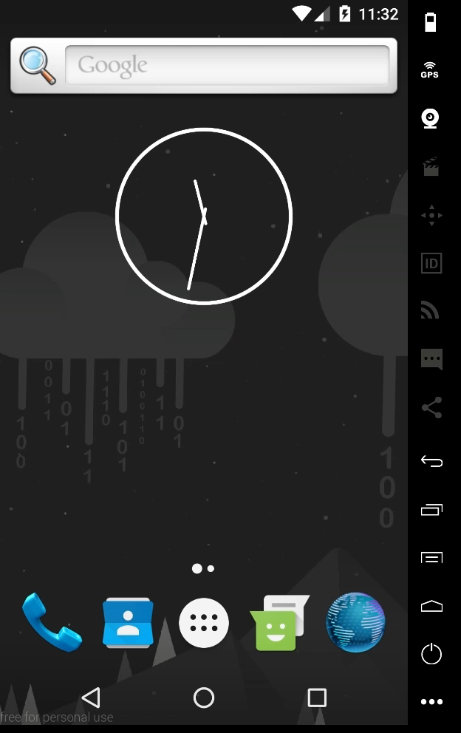
product

Slide 5
Market size
~20,000
~ 400
* 50
387
~400 graduates/year
x 50 English speaking countries
~20,000
potential users/year
387 graduates/year
http://www.info.mua.go.th/information/download.php?file_id=201602121526.xlsx&stat_id=317&id_member

Slide 6
traction

Slide 7
team
Poonawich Siriwongse Na Ayudhaya
– Application Developer, User interface
Thanchanok Sankkaew
– Business Development
Kunnapa Phudthonamochai
– User interface

Slide 8
THANK YOU

